Slide 1
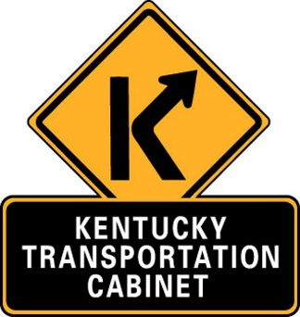
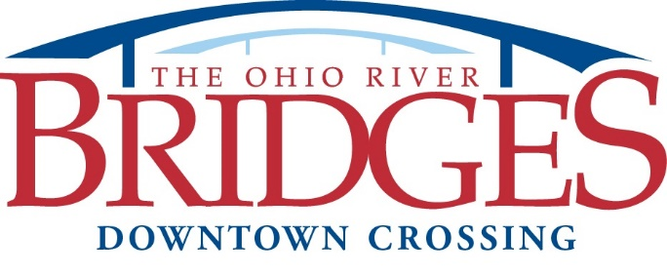
Partners in Progress
Forming Bonds with GECs to Build Roads

Slide 2
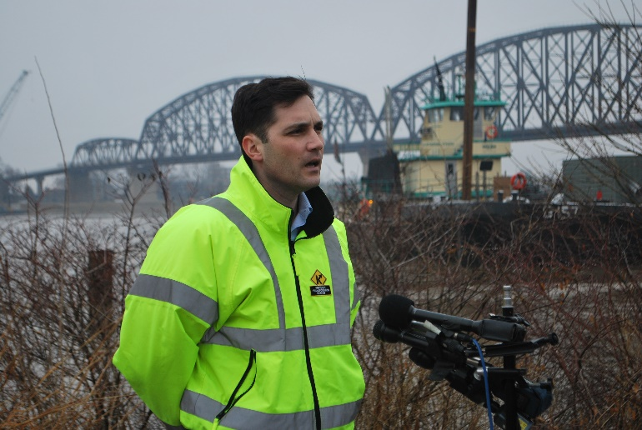
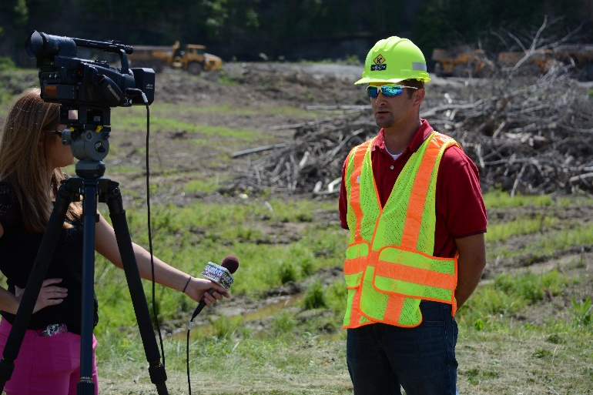
Partners in Progress
Presented by
Andy Barber
KYTC Project Manager,
Ohio River Bridges Project
Marshall Carrier
KYTC Project Manager,
Mountain Parkway
Expansion

Slide 3
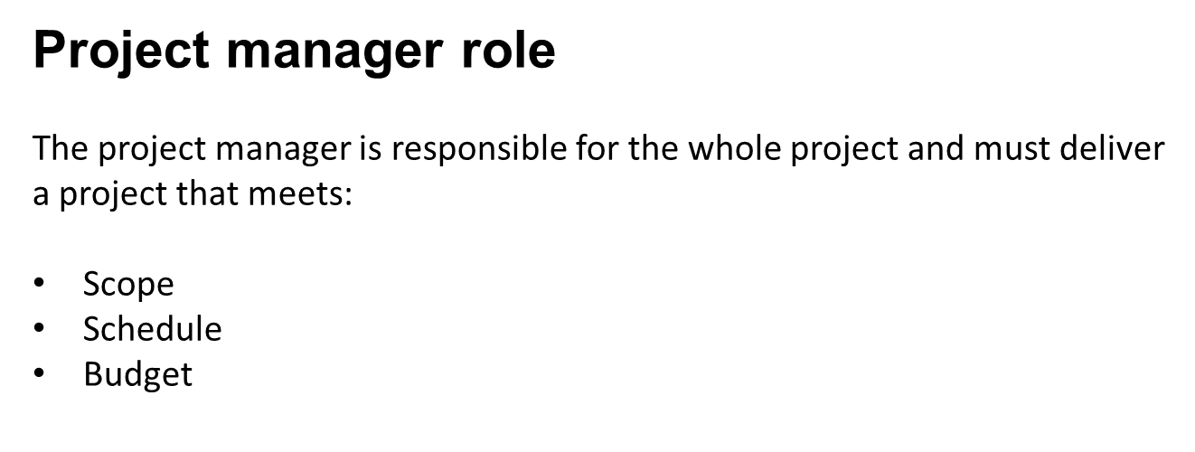
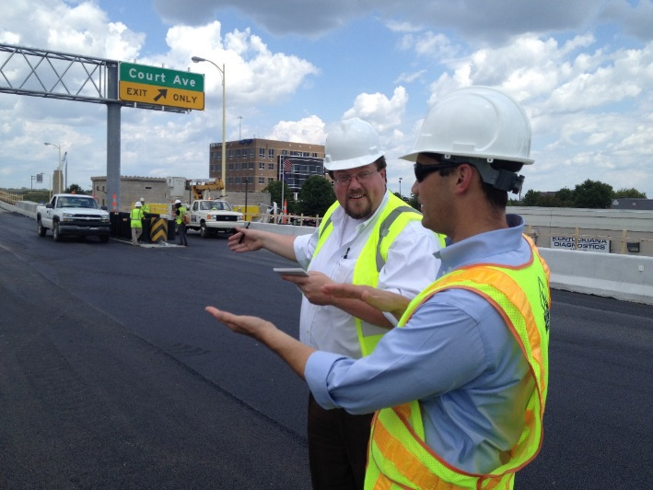
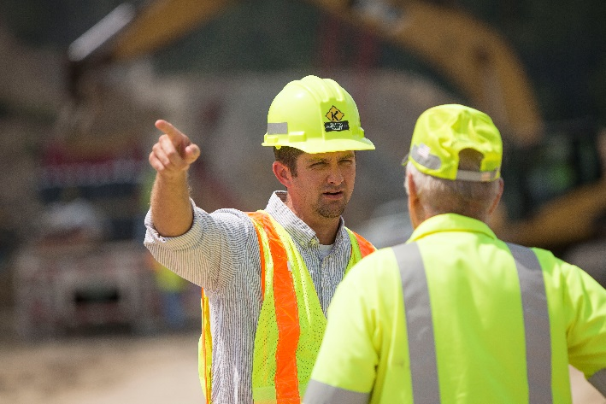

Slide 4
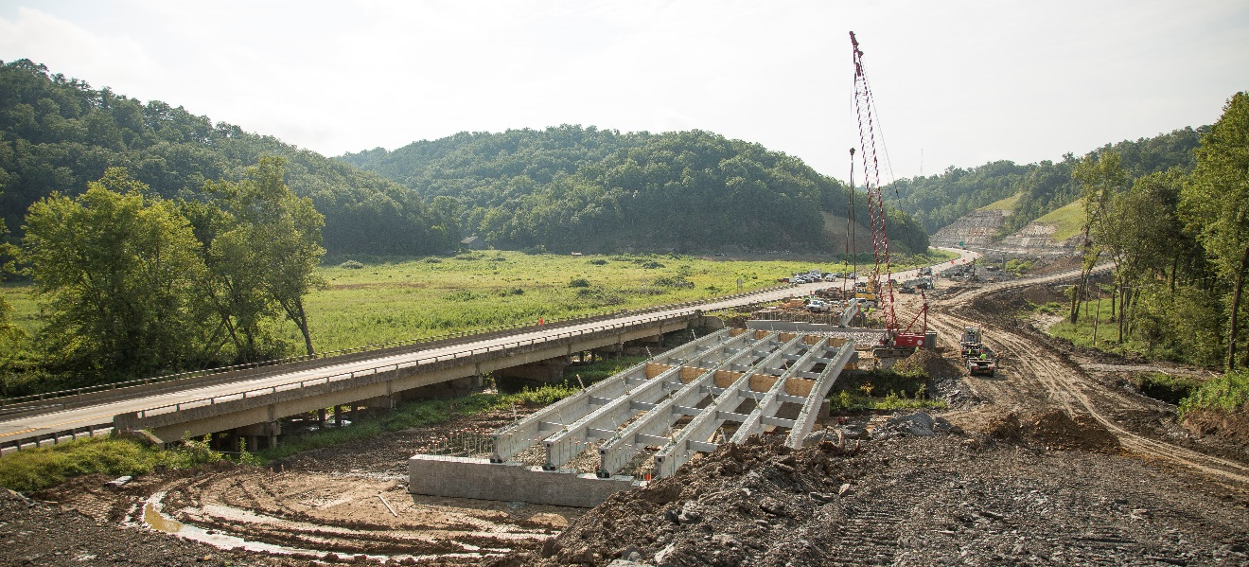
Goals of Presentation
What are GECs?
How are GECs contributing to two current KYTC projects
Insights
Discuss ‘fictions’ about GECs
Q & A

Slide 5
Key responsibilities of project manager
Understanding needs
Building a team
Managing critical paths

Slide 6
What is a GEC?
A General Engineering Consultant is a team of experts that operates as an extension of the KYTC to provide services critical to project delivery.
An alternate tool in the toolbox
Extension of Cabinet and district staff

Slide 7
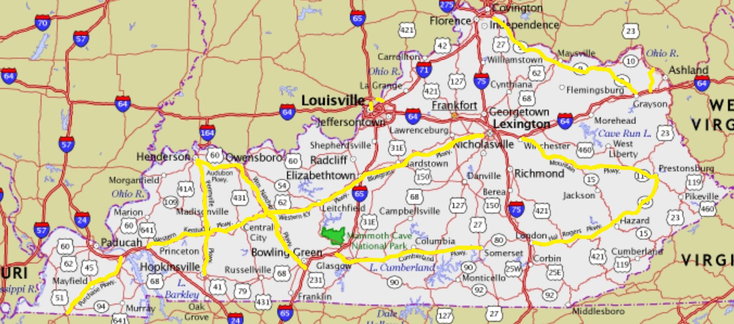
GECs are not new
Parkway systems of the 1960s
AA Highway
Industrial Parkway

Slide 8
Current uses
Louisville-Southern Indiana Ohio River Bridges Project
Mountain Parkway Expansion

Slide 9
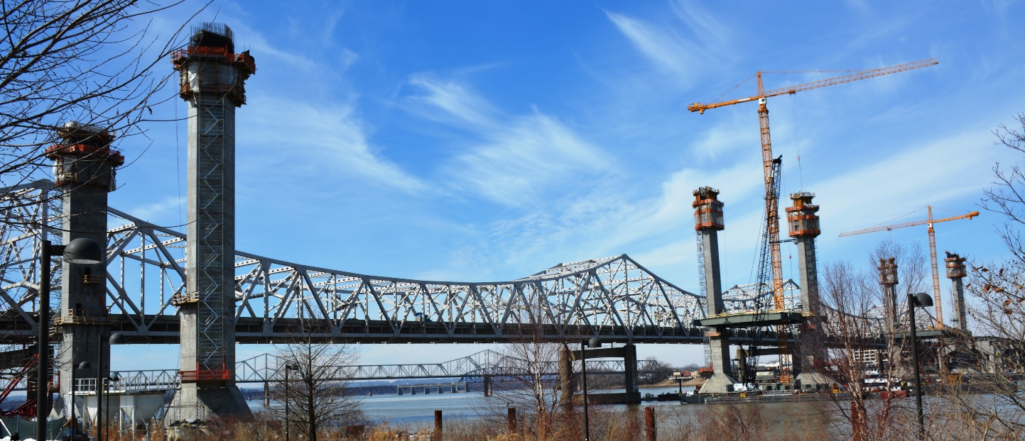
Ohio River Bridges Project
Adding two bridges over the Ohio River between Louisville and Southern Indiana
Reconfiguring interchange in high-traffic, urban area with three interstates

Slide 10
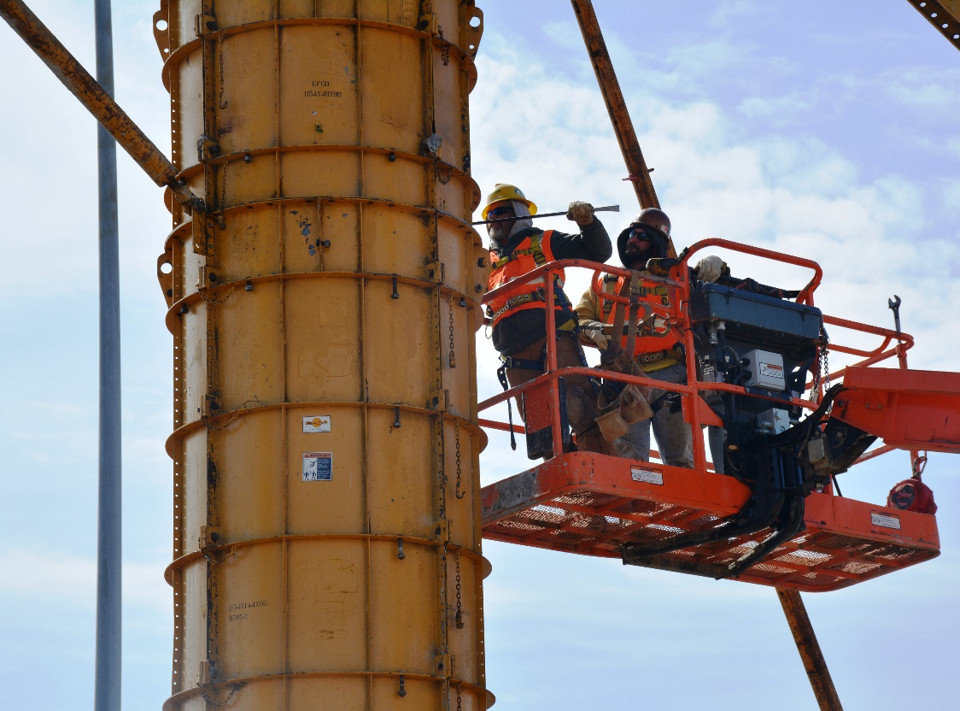
Ohio River Bridges Project
Largest joint transportation project undertaken by KY and IN
Nearly 20 years between start of environmental process to completion
Approximate cost: $2.3 billion

Slide 11
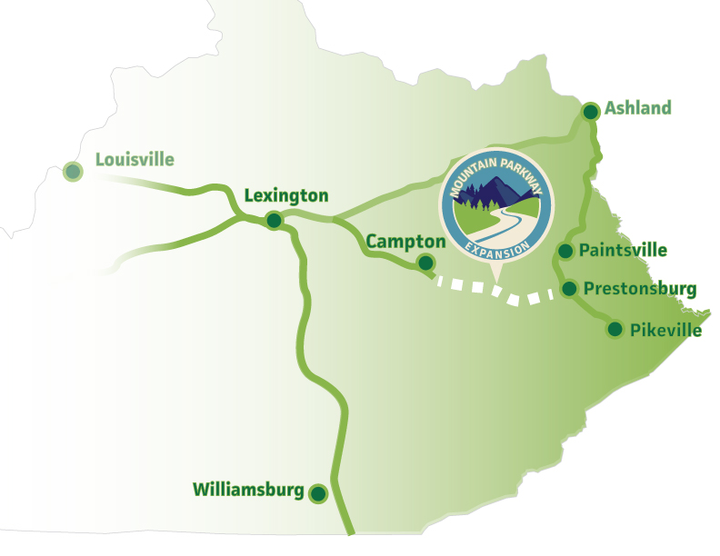
Mountain Parkway Expansion
46-mile transportation improvement project
Six- to 10-year timeframe
Initial estimated cost: $750 million

Slide 12
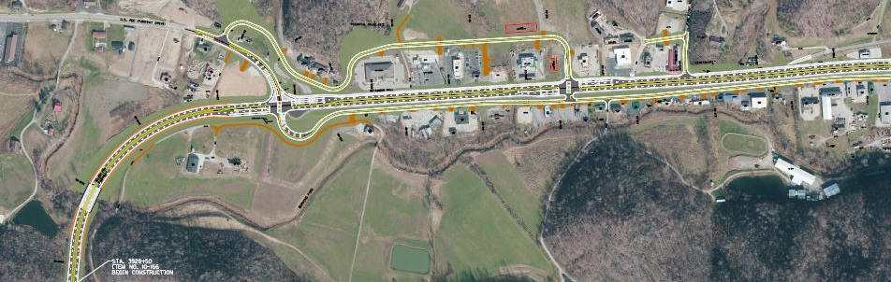
What these projects have in common
Cost
Scale
Complexity
Timetable
Public interest

Slide 13
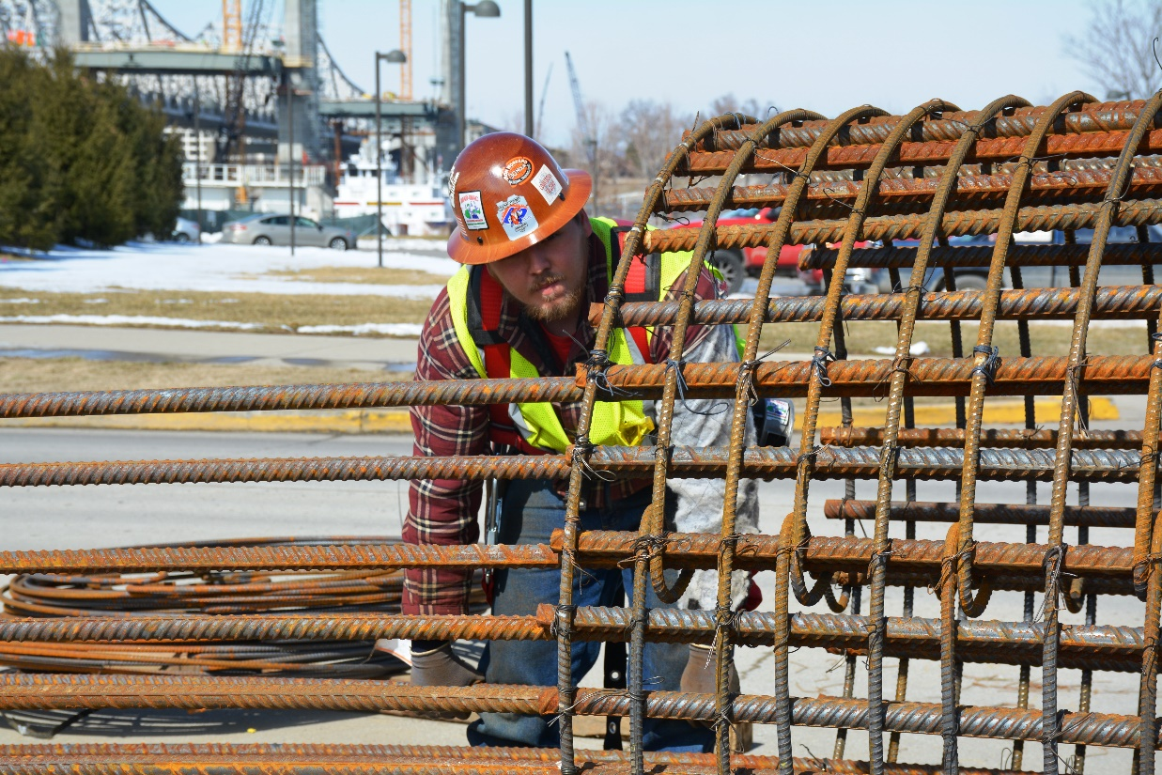
Why GEC?
KYTC’s goal for GECs is to provide experience, continuity over life of long-term, large-scale projects.

Slide 14
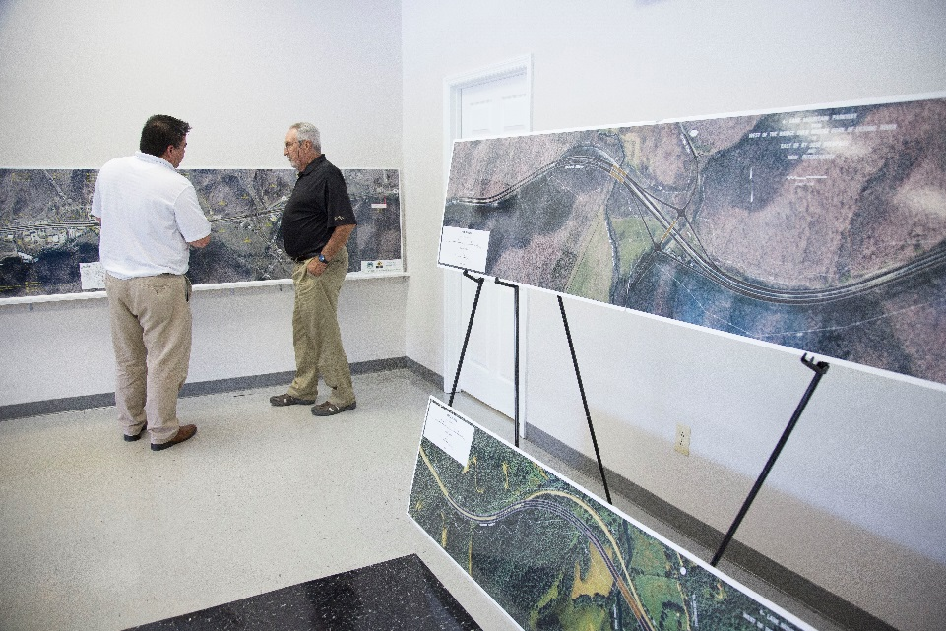
GECs:
Complement existing KYTC staff
Bring experienced, knowledgeable team
Are scalable
Can expedite project delivery

Slide 15
Who is the GEC?
The Mountain Parkway team includes:
Two former deputy SHEs
Three former assistant SHEs
Five former directors (construction, design, structures)
A former CDE
Numerous other former KYTC engineers and managers

Slide 16
Who is the GEC?
The Ohio River Bridges team includes:
Two former deputy SHEs
One former assistant SHE
Four former directors (construction, design)
Numerous other former KYTC engineers and managers

Slide 17
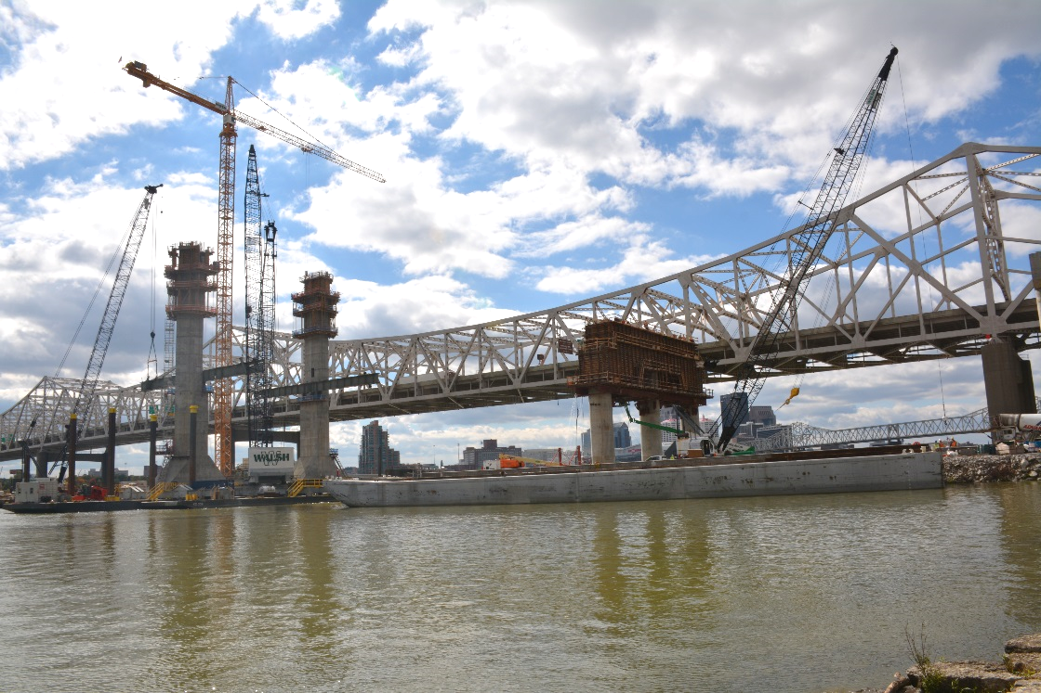
GEC benefits:
Scalable: Resources may be added or reduced as needed
Focused: Team’s attention is solely on project delivery

Slide 18
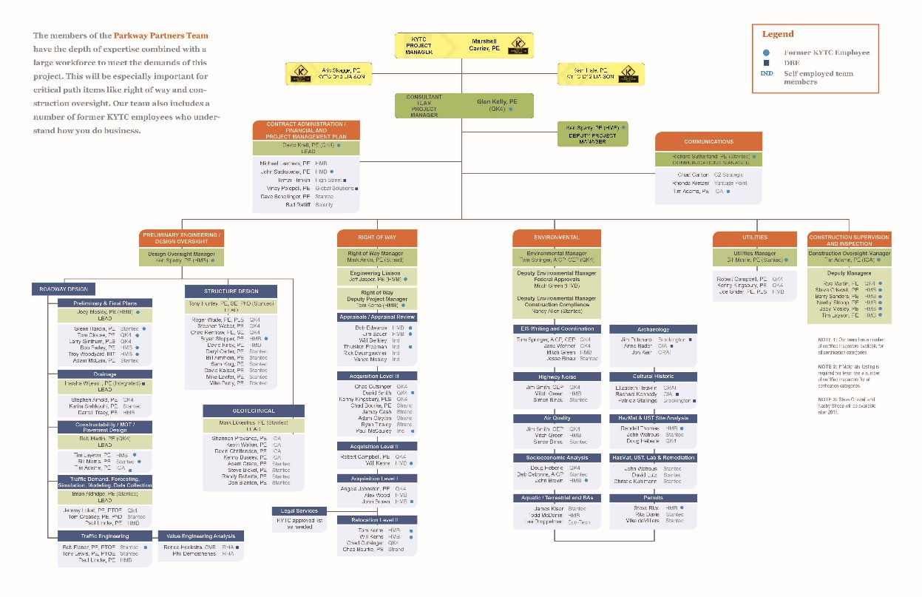
Roles on project team:
KYTC project manager
District liaisons
Consultant team project manager
Managers of key areas

Slide 19
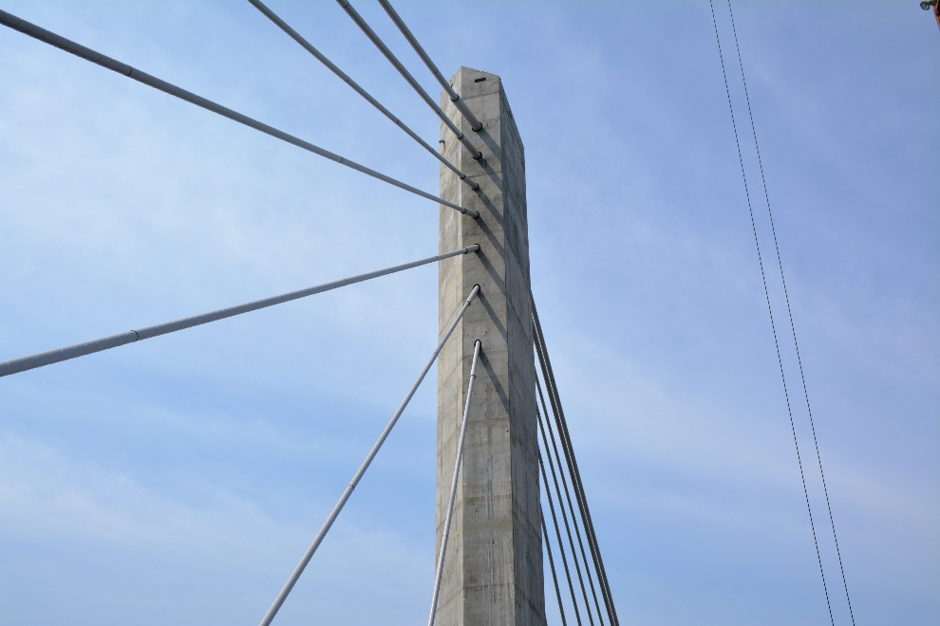
GEC may have wide area of responsibility:
Preliminary design
Environmental
General project management
Preparation of contract RFP
Contract administration
Financial and project management plans
Construction oversight, supervision and inspection
Right-of-way acquisition
Utility coordination

Slide 20
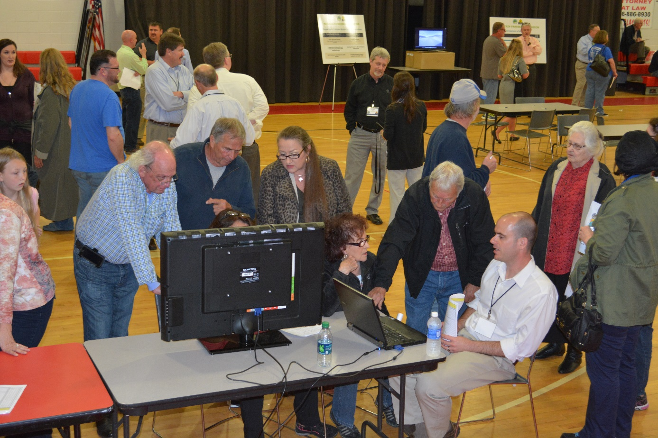
Communications approaches
Project identity
Team communication (GEC, cabinet, districts)
Public information and media relations
Open-house meetings
Milestone events

Slide 21
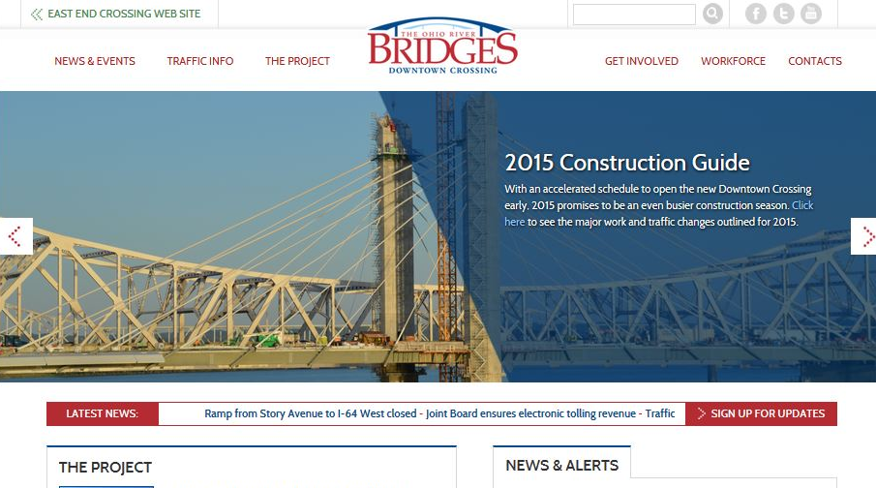
Communications approaches
Project websites
Social media
E-mail communications and e-newsletters
Updates for community leaders
Stakeholder briefings
Mountain Parkway Awareness Council

Slide 22
Where does project manager fit in?
Make sure all the pieces fit together
Make sure all the work is done
Deliver the project, not the bureaucracy

Slide 23
GECs manage critical path by
Maintaining intense focus on one project
Having flexibility to add resources
Providing commitment to longer-term projects
Bringing experience to anticipate/avoid pitfalls

Slide 24
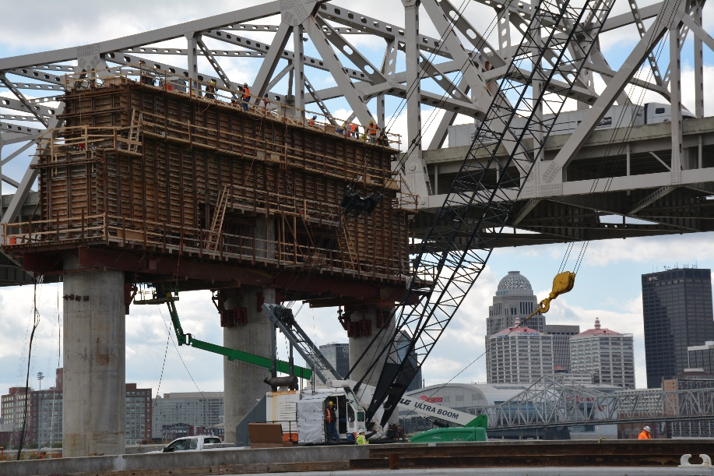
GEC accomplishments: Ohio River Bridges
Cut costs from $4.1 billion to $2.3 billion
Provided alternative design
Sped delivery
Wrote RFP in seven months, compared with typical 18-month time frame
Five-year construction schedule cut to about three years

Slide 25
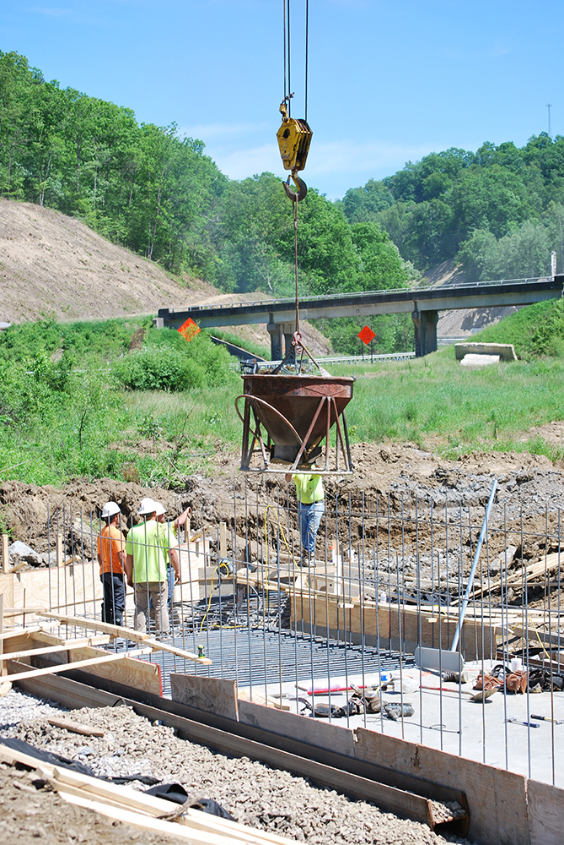
GEC accomplishments: Mountain Parkway Expansion
Found $40 million in cost savings
Restaurant Row
$24 million TIGER grant
Engaged additional financial resource
Completed application in two weeks
Aggressive schedule: Two years from line and grade to construction

Slide 26
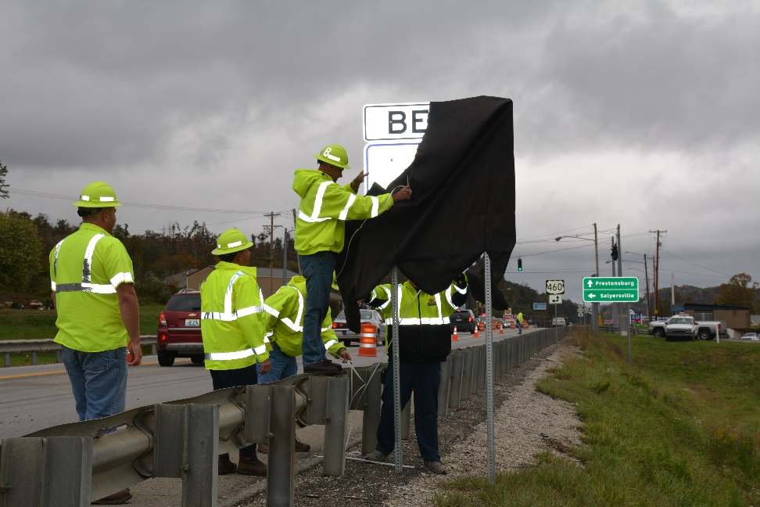
Myths about the GEC
Myth 1: GECs are taking over the Cabinet
Fact: GECs focus on specific projects, not broad programs

Slide 27
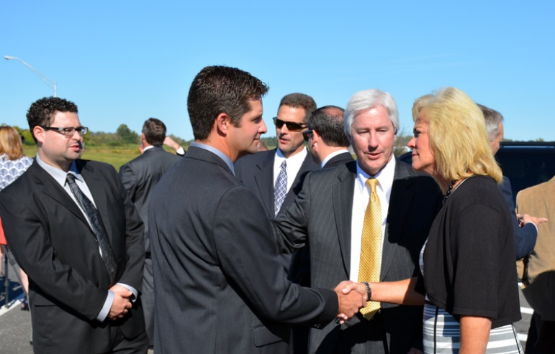
Myths about the GEC
Myth 2: KYTC is outsourcing decision-making for the project
Fact: KYTC provides oversight of GEC
Fact: GEC coordinates with/engages district staff

Slide 28
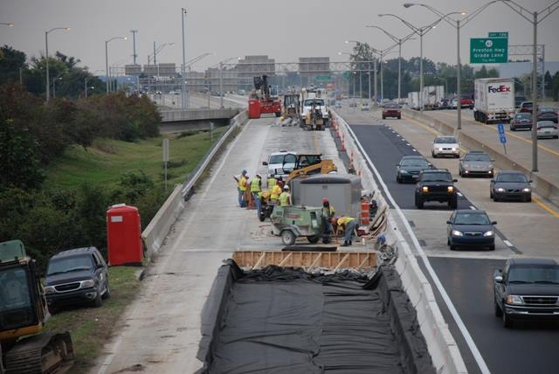
Myths about the GEC
Myth 3: GECs are only useful for mega projects
Fact: GECs can be scaled – the right team is the key.
Can support programs with wide scope.
GECs can be used to expedite priority projects.

Slide 29
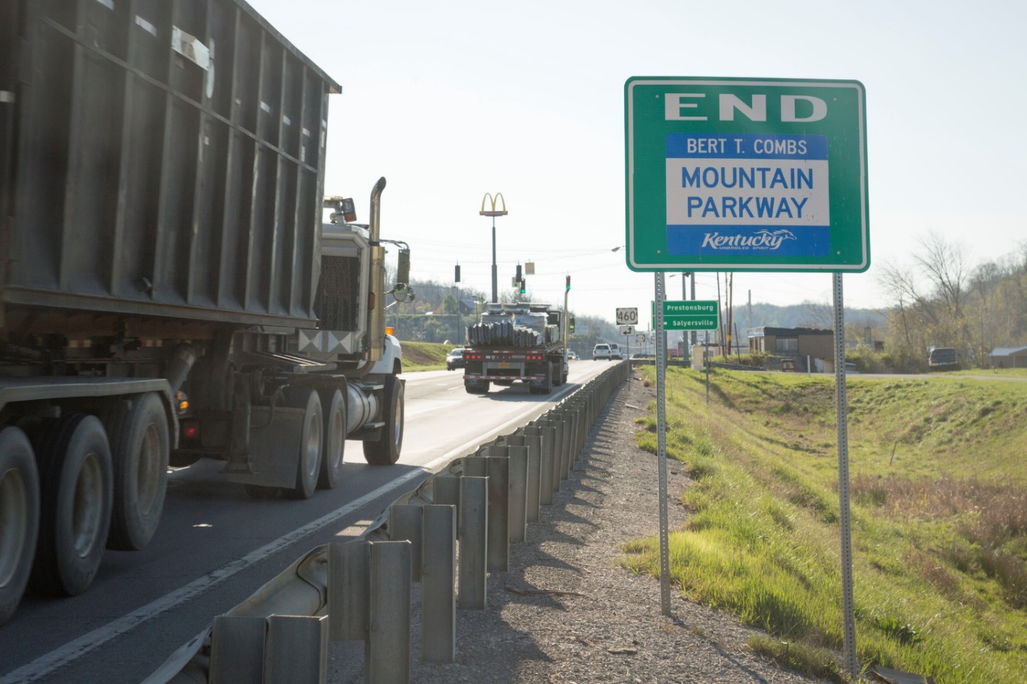
Questions?

